Slide 1
Chapter 40 Mirrors and Lenses

Slide 2
optics
a/λ>>1
a~λ
Geometrical optics
Wave optics
The light travel in straight line paths or rays.
diffraction (physical optics)
Mirrors and Lenses
Image formation by mirrors and lenses

Slide 3
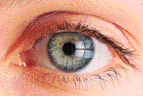

Object and image
Light rays from object and go in all directions.
We can see light rays from object
We know object’s location and color
real image
also from image
the light rays are from image
virtual image
The formation of image
the light rays are not from image, but looks like from image
Reflection Mirrors
Refraction Lenses

Slide 4


Plane Mirrors
Smooth Mirror
θ_{r}
θ_{i}
All rays originating from peak will appear to come from same point behind mirror!
Object
Image

Slide 5

Plane Mirrors
Two mirrors
2
1
3

Slide 6



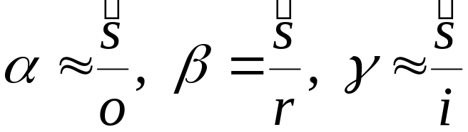

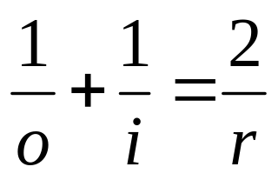
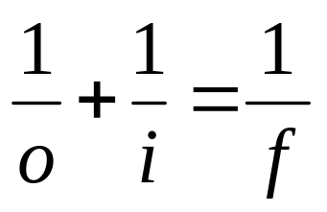
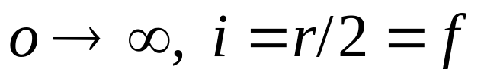
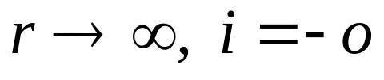
Spherical Mirrors
a
θ
α
β
γ
v
O
C
I
R-side: real image side
V-side: virtual image side
i, o, r, and f are taken to be negative
i, o, r, and f are taken to be positive
i
r
o
focal point
plane mirror

Slide 7


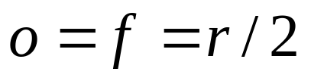


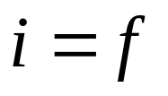
Spherical Mirrors
F
Principal Axis
F
focal point
plane mirror

Slide 8
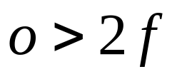




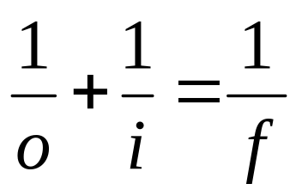
Spherical Mirrors
I
O
C
F
I
O
C
F

Slide 9
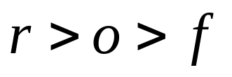

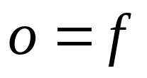

Spherical Mirrors
I
C
O
F
C
F

Slide 10
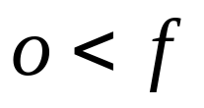

Spherical Mirrors
C
F
O
I
C
F

Slide 11
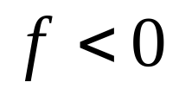
Spherical Mirrors
C
F
O
I
O
I
F
C

Slide 12
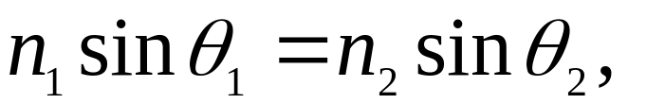
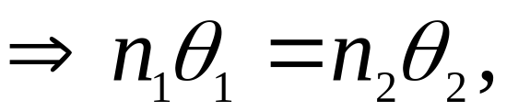
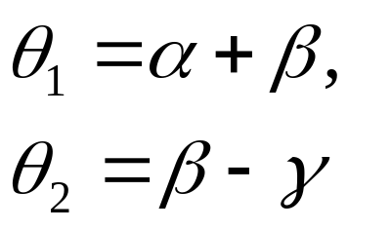
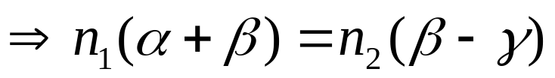
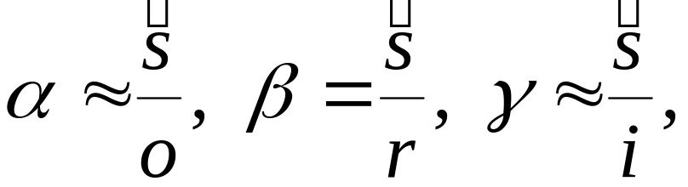
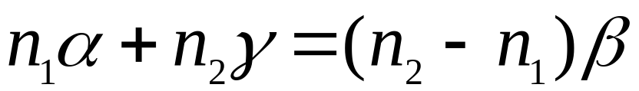
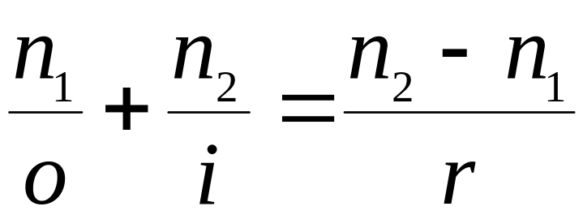
Spherical Refracting Surfaces
θ₁
a
θ₂
α
β
γ
O
v
C
I
n₁
n₂
r
o
i

Slide 13

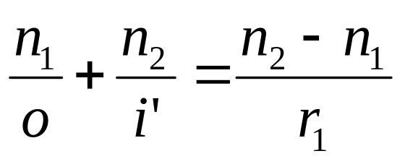
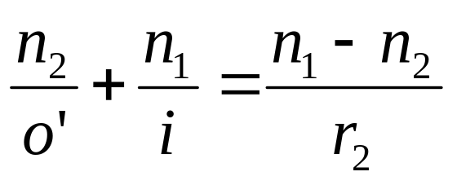
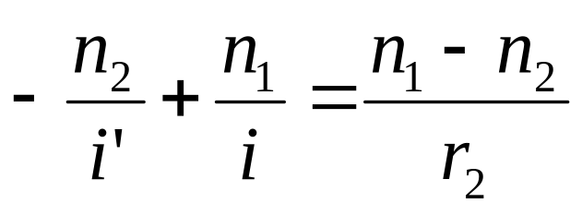
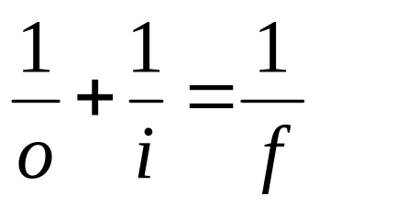
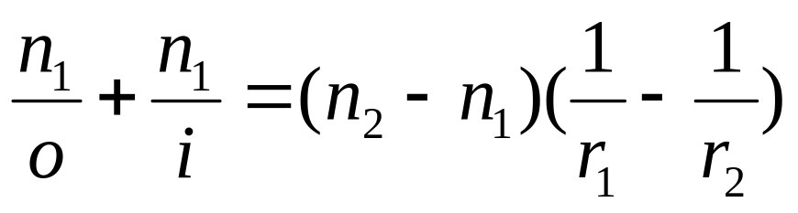
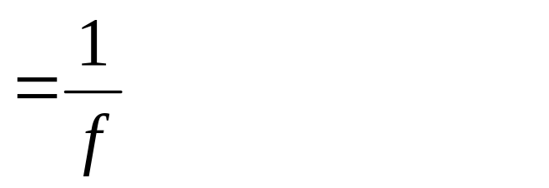
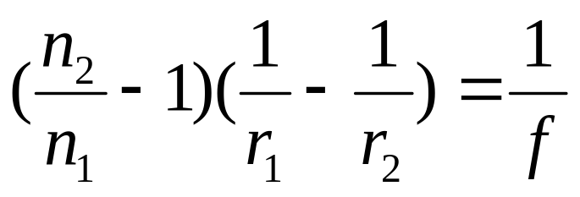
Spherical Refracting Surfaces
Thin Lenses
the thickness of the lens is small compared with the o, i, and the radii of curvature r₁, r₂.
P.A.
n₁<n₂
F

Slide 14
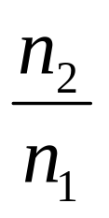
Spherical Refracting Surfaces
Thin Lenses
the thickness of the lens is small compared with the o, i, and the radii of curvature r₁, r₂.
P.A.
n₁<n₂
F
Fat in middle
f >0
P.A.
n₁<n₂
F
Thin in middle
f <0
The larger , the stronger bend

Slide 15
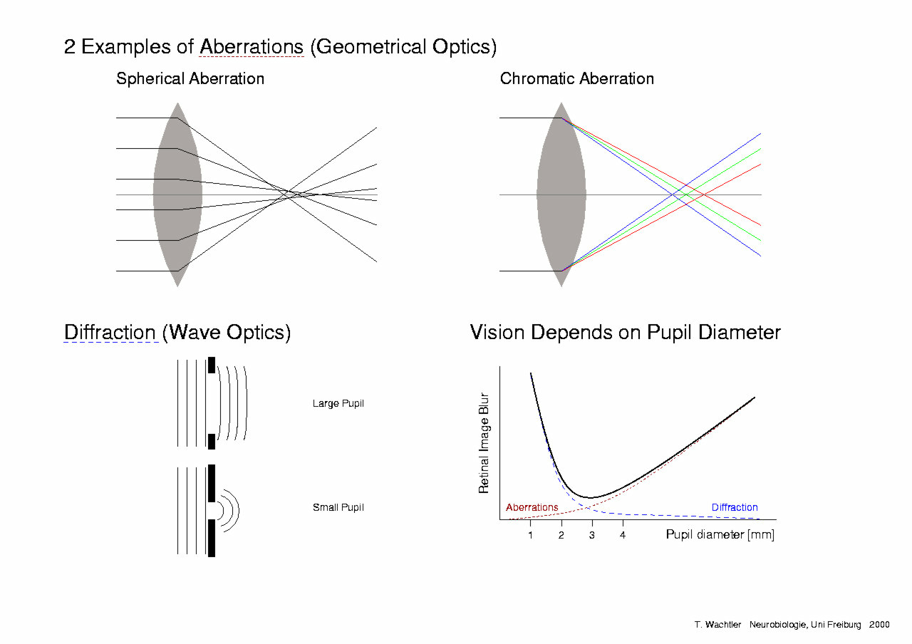
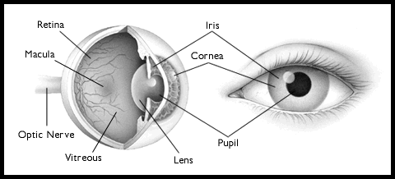
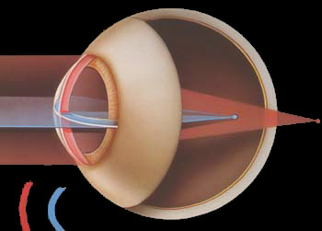
Amazing Eye
Ciliary Muscles
different focal lengths
100 million Receptors
  200,000 /mm²
  Sensitive to single photon!
Candle from 12 miles

Slide 16
Two-lens systems
1
2
f₁
f₂
Lens 1 creates a real, inverted image of the object.
Lens 2 creates a real, inverted and reduced image of the image from lens 1.
The combination gives a real, upright, enlarged image of the object.

Slide 17
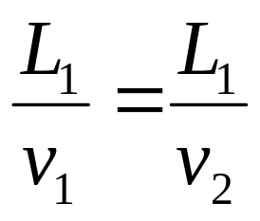
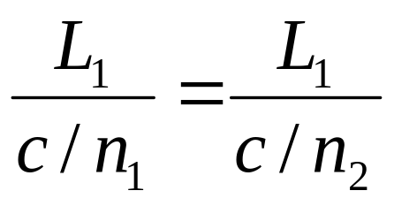
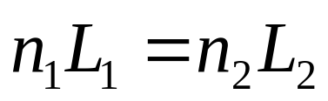
Two-lens systems
All rays go the same length of the optical path !
1
2
f₁
f₂
Fermat’s Principle
A light ray traveling from one fixes point to another fixed point , the time requires is either a minimum or a maximum or remains unchanges.
optical path

Slide 18
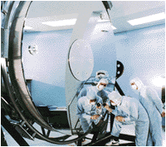
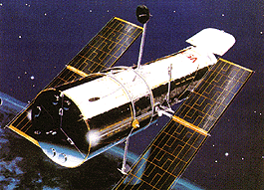
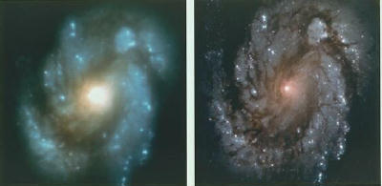
2.4 m and 828 kg
Many-lens systems
Microscope
Telescope
The photo of M110
Hubble space telescope
Before COSTAR
After COSTAR

Slide 19
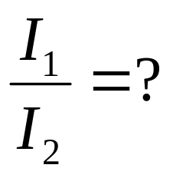





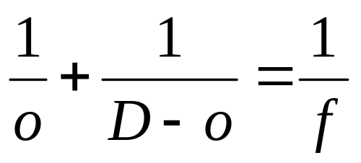


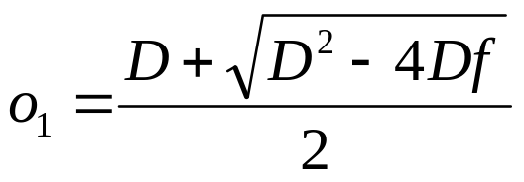
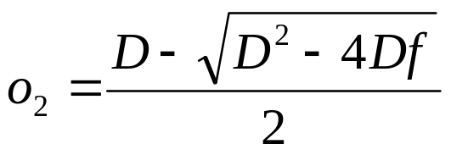
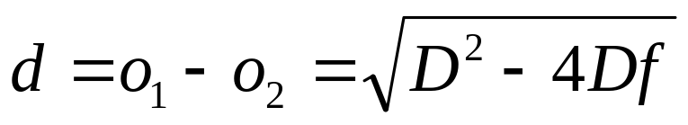
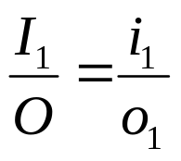
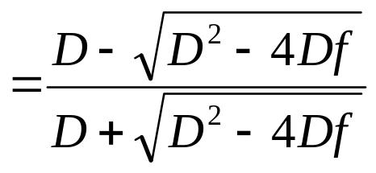
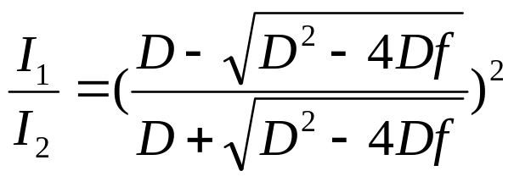
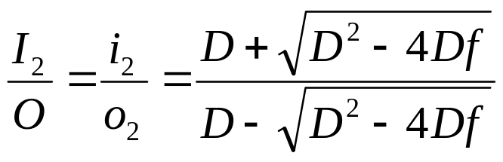
A lens with focal length f
Example

Slide 20




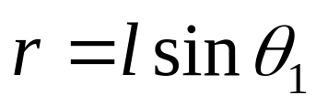
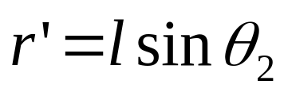

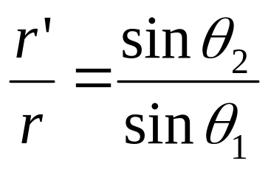

Example
Cross section of a glass tube with internal radius r
r’
r
r’ =?

Slide 21





Example
Mirror with R
v_{o}
o
v_{i} =?

Slide 22










Example
1
2

Slide 23
Problems
P937-938 4, 9, 10, 12, 13

